Slide 1
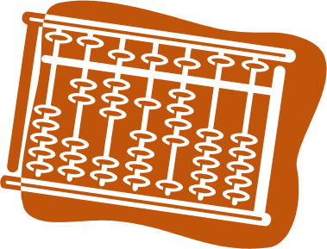
Parallel Programming Principle and Practice
Lab Syllabus
Jin, Hai
School of Computer Science and Technology
Huazhong University of Science and Technology

Slide 2
Objective and Requirement
Understand the purpose, ideas and methods of parallel programming, familiar with parallel computing analysis and problem solving skills
  use the basic principles and methods of using the common tools and program models, such as pthread, OpenMP, MPI, MapReduce and CUDA, to parallel existing algorithms and develop new parallel algorithms
  analysis of parallel processes and results, let the students understand the purpose of the parallelization and reasons of performance improvement on a deeper level of the theories of parallelization, fundamentals of compiling and operating system

Slide 3
Syllabus
Lab
  Lab1 Be Familiar with the parallel programming environment (Required)
  Lab2 Parallel implementation of Morphological Image Processing operation using pthread (Required)
  Lab3 Parallel implementation of Morphological Image Processing operation using OpenMP (Required)
  Lab4 Parallel implementation of Morphological Image Processing operation using MPI (Required)
  Lab5 Parallel implementation of Morphological Image Processing operation using CUDA (Required)
  Lab6 K-means algorithm implementation based on MapReduce (Elective)
Project
  Project1 Solve Sudoku problem using parallelizing backtracking（Elective）
  Project2 parallel optimization of Breadth First Search algorithm （Elective）

Slide 4
Labs
Lab1 Be Familiar with the parallel programming environment (Required)
  become familiar with the parallel development environments, and the basic principles and methods of parallel programming and performance optimization by using tools and frameworks like pthread, OpenMP, MPI under Linux system

Slide 5
Labs
Lab2 Parallel implementation of Morphological Image Processing operation using pthread (Required)
  master the basic principles and methods of parallel programming design and performance optimization using pthread
  understand the basic method for data partition and task decomposition in parallel programming
  implement the parallel algorithm of Morphological Image Processing operation using pthread
  then carries on the simple analysis and summary of the program execution results

Slide 6
Labs
Lab3 Parallel implementation of Morphological Image Processing operation using OpenMP (Required)
  master the basic principles and methods of parallel programming design and performance optimization using OpenMP
  implement the parallel algorithm of Morphological Image Processing operation using OpenMP
  carries on the simple analysis and summary of the program execution results
  compare it with the results of Lab2

Slide 7
Labs
Lab4 Parallel implementation of Morphological Image Processing operation using MPI (Required)
  master the basic principles and methods of parallel programming design and performance optimization using MPI
  implement the parallel algorithm of Morphological Image Processing operation using MPI
  carries on the simple analysis and summary of the program execution results
  compare it with the results of Lab2 and Lab3

Slide 8
Labs
Lab5 Parallel implementation of Morphological Image Processing operation using CUDA (Required)
  understand deeply the architecture of GPGPU and master the CUDA programming model
  implement the parallel algorithm of Morphological Image Processing operation using CUDA
  carries on the simple analysis and summary of the program execution results
  propose optimization solution based on the execution results and hardware environment
  compare it with the results of Lab2 ,Lab3 and Lab4

Slide 9
Labs
Lab6 K-means algorithm implementation based on MapReduce (Elective)
  realize of the K-means algorithm based on MapReduce
  master the MapReduce programming model
  understand the distributed programming methods in cloud computing environments

Slide 10
Project
Project1 Solve Sudoku problem using parallelizing backtracking （Elective）
  master the methods to parallelize and improve a program
  understand the relationship between parallel granularity and performance
  master how to partition data and decompose tasks of a complex algorithm

Slide 11
Project
Project2 parallel optimization of Breadth First Search algorithm （Elective）
  master the two typical parallel program development tools (OpenMP and MPI)
  understand the similarities and differences between the two tools during the process of parallel program design and optimization
  adjust and analyze the parallel granularity of the generated parallel algorithms because of optimization
  further understand the principles of parallel programming and what should pay attention to

Slide 12
实验时间和方式
交流群:243487227
通过账号使用服务器进行实验
随时答疑

Slide 13
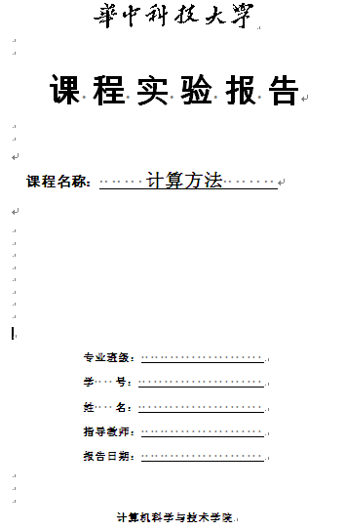
实验报告
实验一
  实验目的与要求
  实验内容
  实验结果
实验二~/五
  实验目的与要求
  算法描述
  实验方案（含开发与运行环境描述）
  实验结果与分析
实验小结

Slide 14
project报告
锻炼分析与解决问题的能力
  我的目的是什么？
  分析问题，做出假设
  我准备用什么方法?
  设计与实现
  结果比较与分析
  思考与总结
Project Name (Your Name, Class, & ID) AIM What are the purposes of this project? HYPOTHESIS Do you have any hypothesis you are going to test in this project? METHODS Detailed description of models, algorithms, experimental scheme, and program design et al. RESULTS Results and necessary explanation DISCUSSION & CONCLUSION

Slide 15
References
The content expressed in this chapter comes from
  Michael Wrinn, Intel Manager, Innovative Software Education
  Nick Efford. Digital Image Processing: A Practical Introduction Using JavaTM. Pearson Education, 2000.

Slide 16
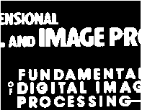
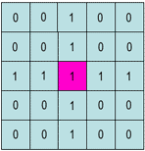
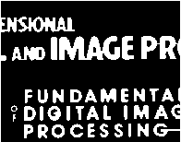


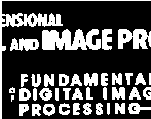
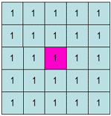
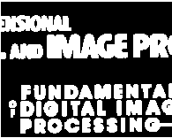


形态学图像处理
蚀刻操作
膨胀操作
https://www.cs.auckland.ac.nz/courses/compsci773s1c/lectures/ImageProcessing-html/topic4.htm

Slide 17
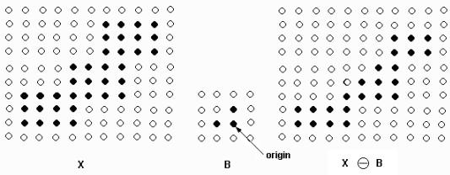
形态学图像处理
例：二值图像的腐蚀处理
X - 被处理的图象
B - 结构元素
Origin - 结构元素的中心点
腐蚀操作的方法：
Origin点和X上的点依次对比
如果B上的所有点都在X的范围内，则该点保留否则将该点去掉；

